Slide 1
Singapore’s Integrated
Land Use Planning Experience
Wong Kai Yeng
27 August 2018

Slide 2
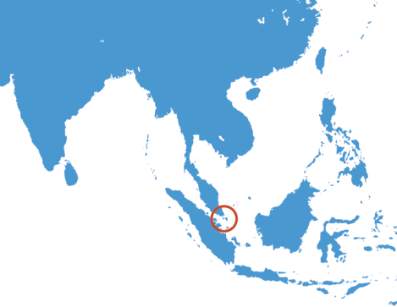
CHINA
INDIA
THAILAND
PHILIPPINES
VIETNAM
SRI LANKA
MALAYSIA
SINGAPORE
INDONESIA

Slide 3
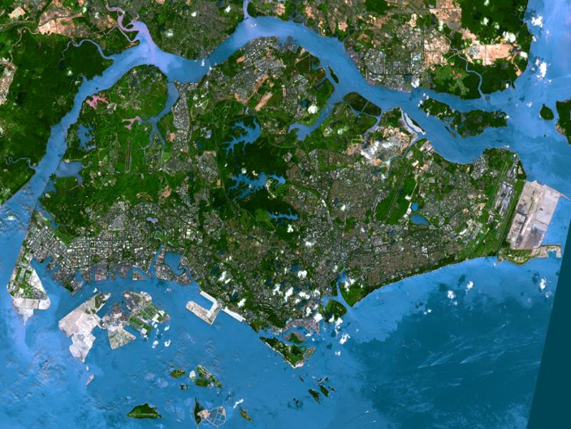
23 km
43 km
Land area: 718km²
Population: 5.5 million
Density: 7660 persons/km²

Slide 4
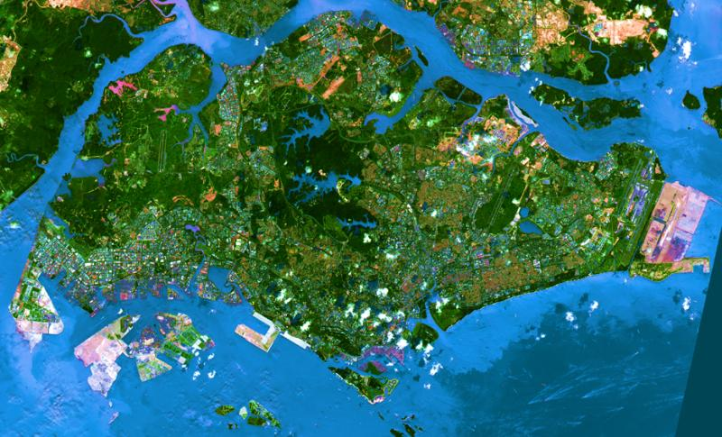
Our Constraints
CITY-STATE
No natural resources
Competing land uses
No hinterland
Height constraints
Land needed for national purposes
Limited land area

Slide 5
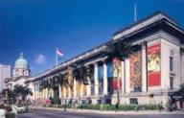
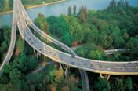
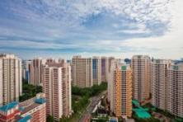

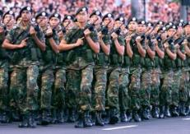
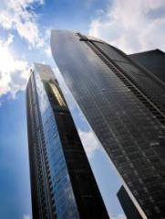
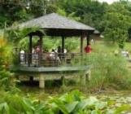
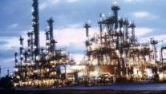
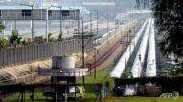
Singapore: A City-State
Balancing different land use needs
Housing
Culture and Heritage
Roads & Infrastructure
Airport
Nature and Greenery
Defence
Commerce
Industry
Water Supply

Slide 6
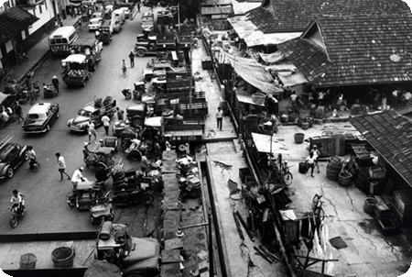
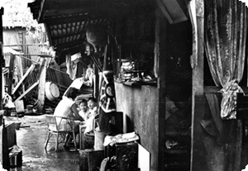
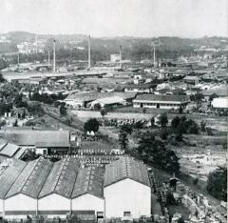
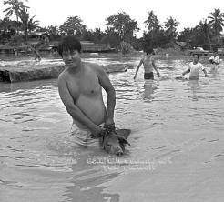
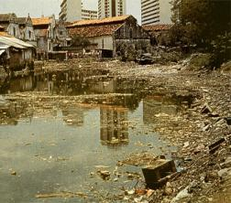
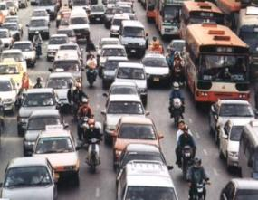
Singapore in 1950s & 1960s
Poor living condition, overcrowding, traffic congestion, inadequate infrastructure

Slide 7
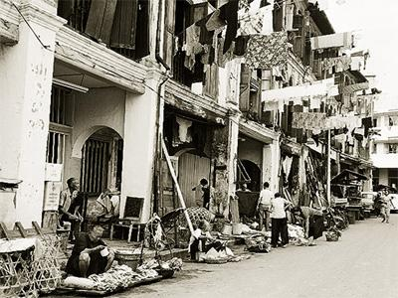
Poor Living Conditions in the 1950-60s
Overcrowded squatters
Source: Urban Development Authority (URA)

Slide 8
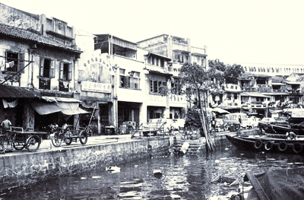

Slide 9
LONG TERM FORWARD LAND USE PLANNING
PLAYS A KEY ROLE IN SINGAPORE’S
DEVELOPMENT
PLANS ARE IMPLEMENTED/REALISED

Slide 10
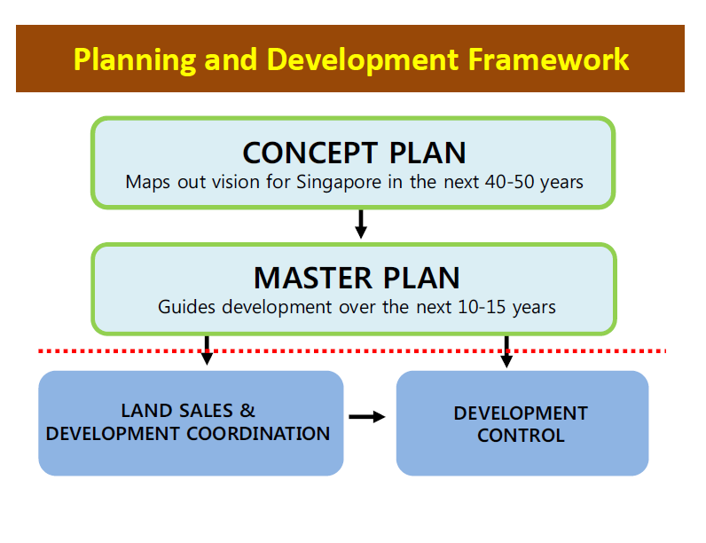
Notes:
As we have shown in the last 3 days, urban planning in Singapore is a very disciplined and rigorous process as land resources are extremely scarce.
The master plan allocates land for competing uses such as housing, commerce, industry, transport, recreation and defence for various locations and determines the development intensity, storey height and building form.
But plans are just plans. When does it become reality?
The way Singapore looks today is a large extent a result of the government’s effective implementation of its urban development plans.

Slide 11
SINGAPORE GOVERNMENT STRUCTURE
Cabinet/Parliament
Ministry of Transport
Ministry of the Environment & Water Resources
Ministry of Law
Ministry of National Devt
Ministry of Trade & Industry
Other Ministries
Urban Redevelopment Authority
Maritime & Port Authority
Singapore Land Authority
National Environment Agency
Economic Devt Board
Civil Aviation Authority
Housing & Devt Board
Building & Construction Authority
International Enterprise Singapore
Land Transport Authority
Public Utilities Board
National Parks Board
Jurong Town Corporation
Agri & Vet Authority
Singapore Tourism Board
Dept of Statistics
Ministries
Stat Boards

Slide 12
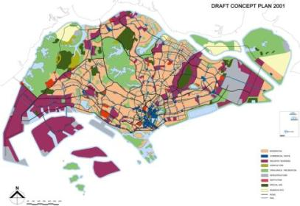
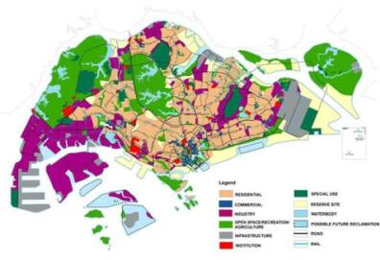
Concept Plan
Concept Plan
Long term planning horizon
Charts the strategic growth direction
Balance between different land use needs
Reviewed every 10 years
Master Plan
Concept Plan 2001
Key Parameters
Demography
Population size
Economic growth
Land Sales
Development Control
Concept Plan 2011

Slide 13
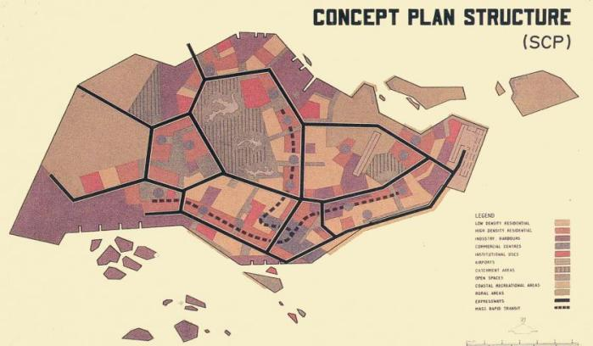
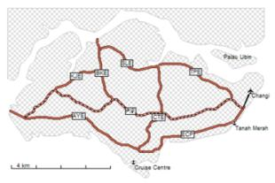
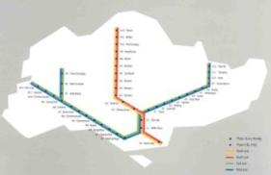
Land Use Concept Plan 1971
Planning Ahead……
1987-90 MRT Network
Expressways

Slide 14
Preparation of The Concept Plan –
Inter-Agency & Whole-of-Government Effort
Steering Committee
Chaired by MND
Population and Housing
HDB, MEWR, MCYS, MND, MOT, MOL, PPU, URA
Transportation
LTA, MOT, MND, HDB,, MPA, PUB
Commerce
MND, EDB, HDB, STB, URA
Central Area
URA, MOT, NParks, LTA, HDB, STB
Environment
URA, MEWR, MND, EDB, HDB, JTC, MPA, PUB
Industry
EDB, MEWR, MOL, MND, MTI,, CAAS, EDB, HDB, JTC, NCB, URA
Recreation
NParks, MEWR, MCYS, MOT, MND, EDB, NUS, PSA, SSC, STB, URA
CAAS
EDB
MEWR
HDB
JTC
LTA
MCYS
MOT
MND
MOF
Ministry of Law
Ministry of Trade and Industry
National Computer Board
National University of Singapore
Population Planning Unit
National Parks Board
Maritime and Port Authority
Public Utilities Board
Singapore Sports Council
Singapore Tourism Board
Urban Redevelopment Authority
Civil Aviation Authority of Singapore
Economic Development Board
Ministry of the Environment & Water Resources
Housing & Development Board
Jurong Town Corporation
Land Transportation Authority
Ministry of Community Devt, Youth & Sports
Ministry of Transport
Ministry of National Development
Ministry of Finance
MOL
MTI
NCB
NUS
PPU
NParks
MPA
PUB
SSC
STB
URA
Notes:
How did we manage to balance development pressures with environmental concerns? We used an integrated planning approach. Singapore’s Concept Plan is drafted once every 10 years by the national planning agency with inputs from an inter-ministry committee. Sub-committees are created to look into population, housing, transportation, commerce, central area planning, industry and very importantly, environment and green spaces (recreation). This meant that while we looked after the key needs of providing jobs via industries and homes for the people, we also ensured that water catchment areas were protected and sufficient parks and gardens were provided as green ‘lungs’ amidst a rapidly urbanising island.

Slide 15













Close Inter-Agency Collaboration

Slide 16
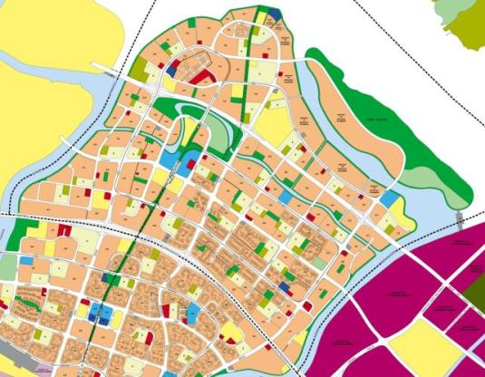
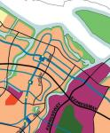
Master Plan
Statutory land use plan
Guides development on each plot of land
Reviewed every 5 years
Concept Plan
Master Plan
Concept Plan
Master Plan
Land Sales
Development Control

Slide 17
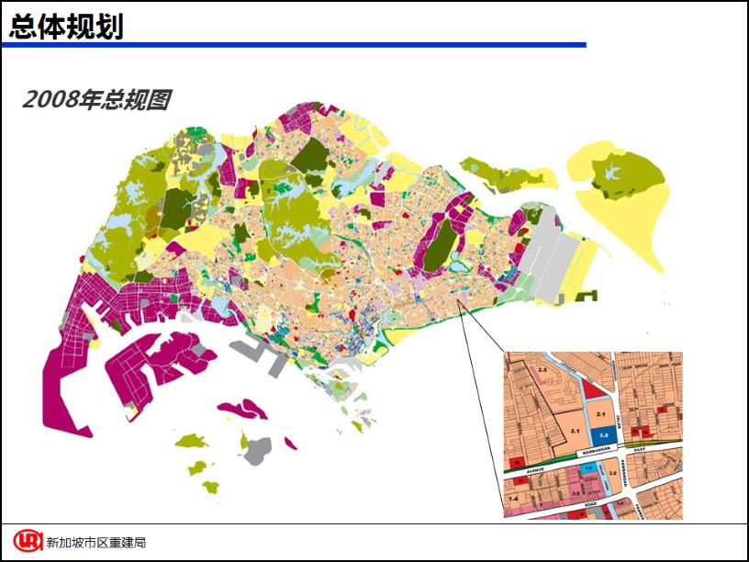
MASTER PLAN 2008

Slide 18
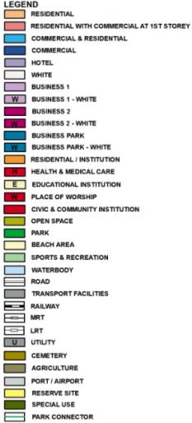
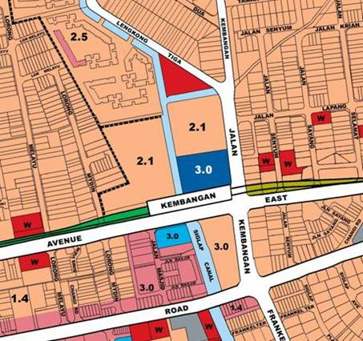
Integrated Master Planning
Notes:
How to read the master plan
Land use – reflective of intended land use, may not be what is on ground
GPR: intensity
Height controls
Implementation timeframe: 10-15 years

Slide 19
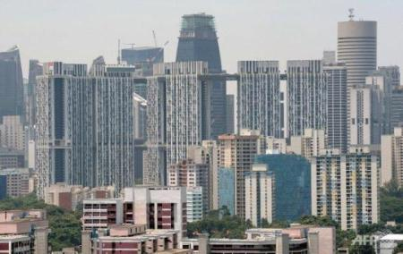
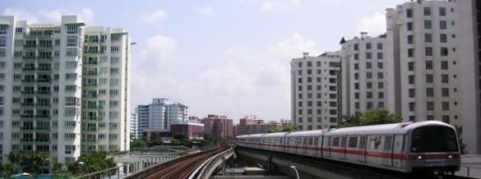
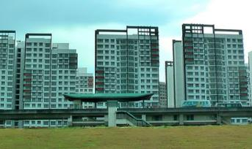
Planning for a Compact & Liveable City
Compact development model
High density yet liveable

Slide 20
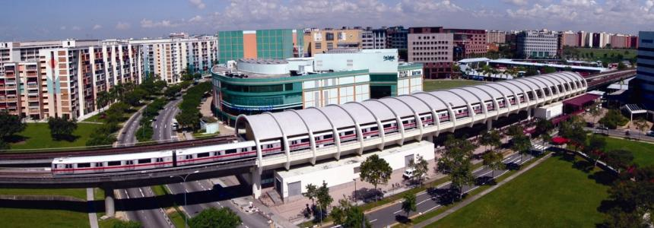
Integrated Land Use and Transport Planning
Planning for land use and transport networks done together
Emphasis on public transport especially MRT/Metro
Tampines Regional Centre in the east
Notes:
20

Slide 21
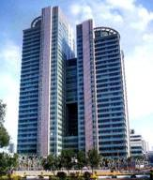
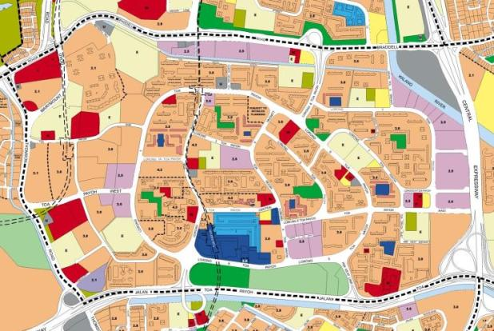



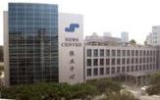
Integrated Township Planning
463ha; 102,100 population
Toa Payoh
Office
School
Nursing Home
Town Park
Civic & Community Institution
School
Town Centre
Park
Polyclinic
Industry
Industry

Slide 22
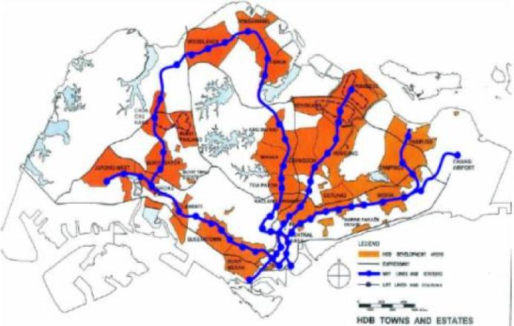
INTEGRATED PUBLIC HOUSING AND PUBLIC TRANSPORT PLANNING & DEVELOPMENT

Slide 23
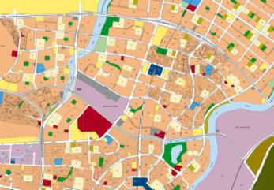
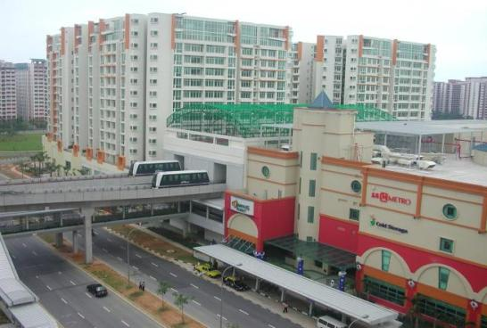
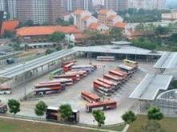
Integrated Transport Hub
Sengkang New Town
(95,000 Dwelling Units)
Sengkang LRT
Sengkang Station
North East Line
Residential
Bus Interchange
MRT (Underground)
LRT
Commercial
Taxi
Car Pick up/ Drop off

Slide 24
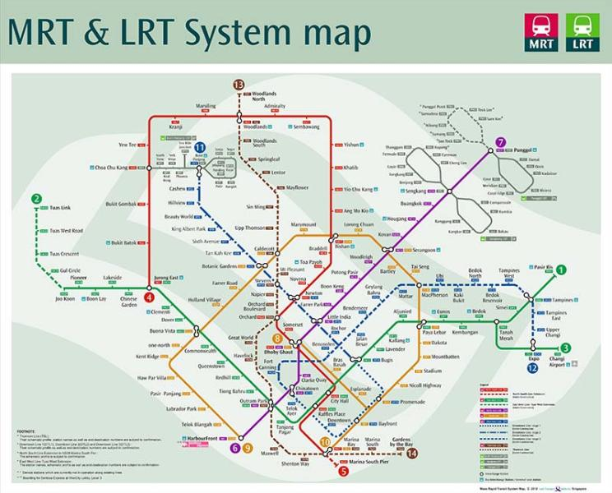

Slide 25
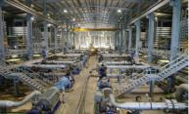
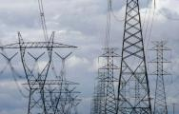
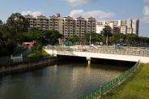
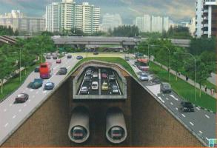
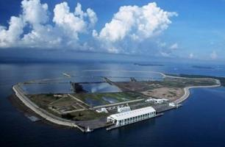
Master Plan: Infrastructure
Concept Plan
Master Plan
Urban design
Infrastructure
Focus areas
Water
Power
Drainage
Land Sales
Development Control
Road & Rail
Waste

Slide 26
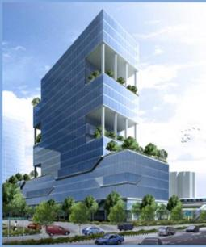
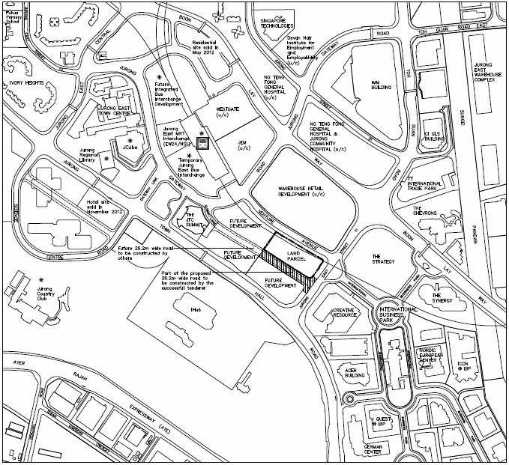
Government Land Sales
Concept Plan
Sale of state land to private enterprises for development
To realise planning intentions
Tool to calibrate real estate market
Sale Site at Venture Avenue
Allowable development: Commerical (with a minimum component for office use)
Tender closing: 12 March 2013
Master Plan
Land Sales
Development Control

Slide 27
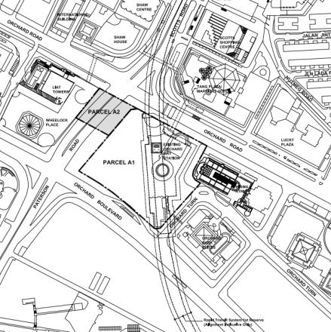


Government Sale of Sites - Ion Orchard
Site above operating underground MRT station
Mixed use development
Seamless access connection integration
Former MRT entrance
ION Orchard

Slide 28

Development Control
Concept Plan
Approval before construction
Ensures that all developments are in accordance with the Master Plan
Macro & micro parameters
Master Plan
Planning Permission
Change of use
Land Sales
Development Charge
Development Control
Enforcement

Slide 29
Planning for Sustainability
Economic driver
Meet the needs of economic development
Social driver
Meet the needs of the people
Environmental driver
Provide & maintain a high quality environment
Society
Sustainable Development
Environment
Economy

Slide 30



Competitive Economy: Moving up the value chain
Job Creation & Economic Growth
2000s: Knowledge Intensive
Per Cap GDP US$
1990s: Technology Intensive
1970-80s: Capital intensive
1960s: Labour intensive
Clean Tech Park
Jurong Island
Singapore River
US$428

Slide 31

DISTRIBUTION OF INDUSTRIAL LAND
地铁线
高速公路
工业区
住宅区

Slide 32

Decentralisation
GROWTH THROUGH DECENTRALISATION

Slide 33





Creating a Vibrant City Centre to Support Growth
Seamless extension of the existing CBD
Marina Centre – Convention/Hotel
Bayfront before
Central Business District
Notes:
33

Slide 34

Sustainable Environment:
Clean & Green Singapore
..we’ve got to keep pollution down because…if you pollute one part of Singapore, you’ve polluted the whole of it
Lee Kuan Yew,
Singapore’s first prime minister

Slide 35
Singapore -- a model of balanced and pragmatic urban development
Resource constraints, small land area, high population density mean we need to take a balanced development approach rather than a “grow first, clean up later model”
While we grow economically, this has not been at the expense of the environment or quality of life of citizens

Slide 36






Garden City to a City-in-a-Garden
Notes:
36

Slide 37






Green & Blue Connectors
Transforming into a City of Gardens and Water
The ABC Programme
Water is now an environment asset, not just a resource
Alexandra Canal
Pandan Reservoir
Seng Kang Floating Wetland
Bishan – Ang Mo Kio Park

Slide 38




HERITAGE & CONSERVATION

Slide 39




PUBLIC INSTITUTIONS

Slide 40




RELIGIOUS
BUILDINGS

Slide 41
Key Planning Principles
Having flexibility within certainty
Adopting an Integrated Approach
Having an open & transparent system
Taking a balanced view towards social, business, environmental needs
Taking a long term view

Slide 42
Enabling Factors
Political Will & Stability
Good Governance
Simple & Efficient Administrative System
Ability to implement plans
Inter-agency cooperation

Slide 43

Thank you！

